Slide 1

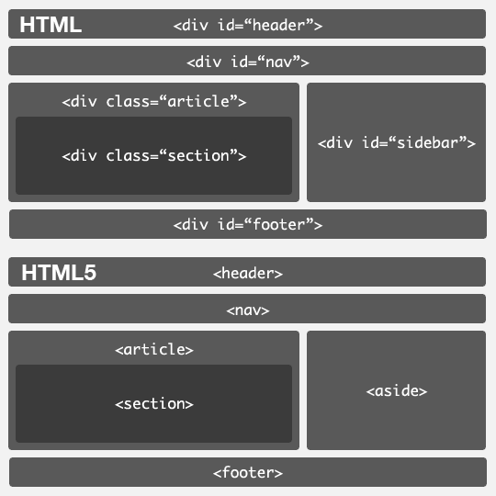
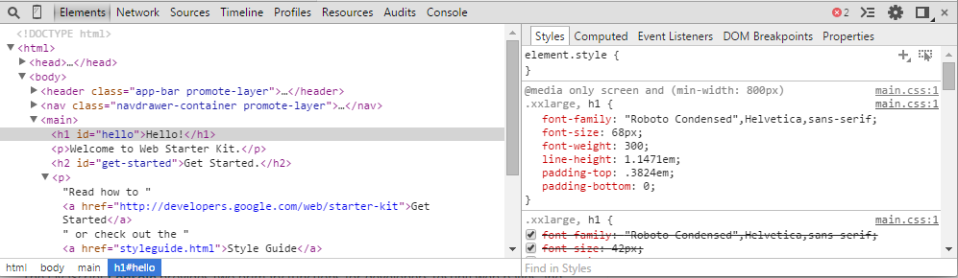
INTRO TO HTML & CSS
HTML:
Section
Header
Footer
Content
Text
Images
Input
Forms

Slide 2
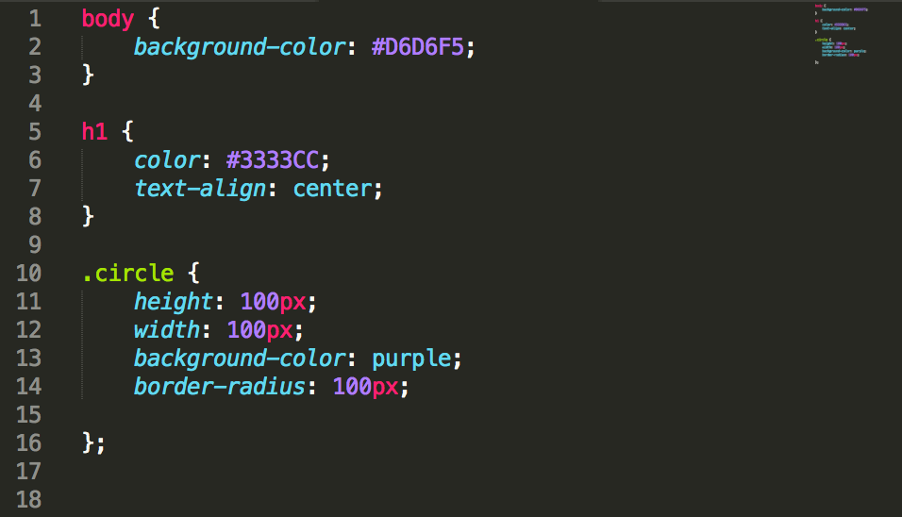
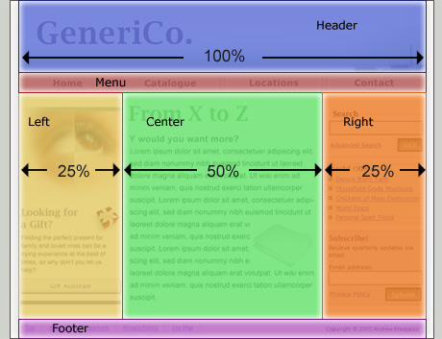
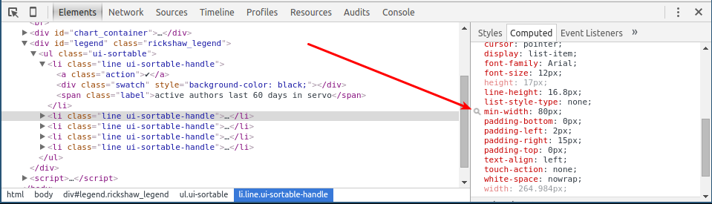
INTRO TO HTML & CSS
CSS:
Style
Color / background image
Typography
Element Sizing
Layout
Display type
Inline elements
blocks
Dimensional size
Box model
Element relation
Positioning context
Stacking context
Interactive states
Hover
Transition
focus

Slide 3
INTRO TO HTML & CSS

